Slide 1
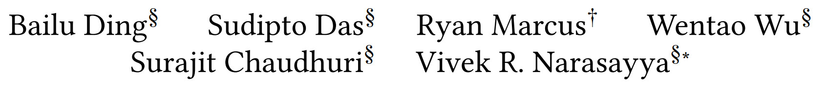
AI Meets AI: Leveraging Query Executions to Improve Index Recommendations
SIGMOD ’19, June 30–July 5, 2019, Amsterdam, Netherlands
尚睿涛
2020/12/23
Notes:
Section3 how to featurize query plans (i.e., trees of operators) into vectors
Section4 how to learn such a classi!er
4.1 we learn an offine model across the databases
4.2 讨论训练集和测试机不同数据分布的问题
4.3 使得跨数据库离线模型适应单个数据库和工作负载
Section6 替代模型

Slide 2
Motivation
Problems
New Approach
query performance regressions
state-of-the-art index tuners
no query regression constraint
+
machine learning
Existing Solutions
query optimizer’s cost estimates
improve index
recommendation quality
Cost estimation errors
Notes:
自动索引的主要障碍是：是更改索引后查询的执行成本增加，即性能下降 ；用户希望达到无查询性能下降
现有的方法：依靠查询优化器的成本估算来推荐改进幅度最大的索引；比较与同一查询的不同计划的执行成本

Slide 3
Contribution
• training a classifier to compare the cost of two plans can be more accurate.
• We present a technique to featurize query plans into vectors and present a thorough study of model alternatives.
• We present a lightweight approach to adapt the models to new execution data to tackle the scenario where train and test data have different distributions.
• We show how an index tuner can use this classifier to significantly improve its recommendations while still being “in-sync” with the optimizer.
• We present an extensive evaluation of our techniques using a diverse collection of benchmarks and real workloads.

Slide 4
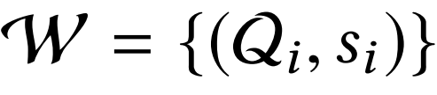



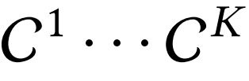







Problem statement
1、Continuous Index Tuning
Workload
lowest execution cost
is a query ; is its associated weight
a sequence of configurations
find the best at each iteration k.
2、Classification Task
ExecCost
Plan
regression
Conf
Query
improvement
Conf
Plan
unsure
Notes:
找到最佳配置顺序需要彻底地搜索，这样做代价非常高，于是当先最新的索引调节器将问题转变成 每次迭代的时候找到最好的配置
运行过程本（cpu时间 处理的字节数等等）

Slide 5
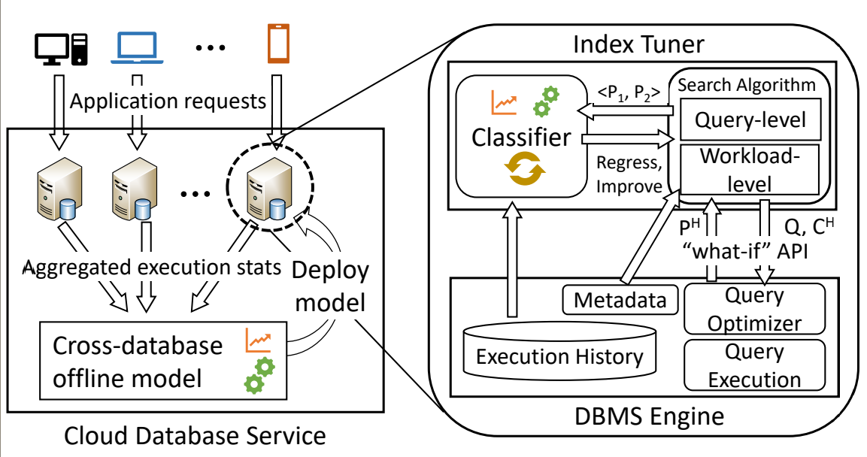
Architecture

Slide 6
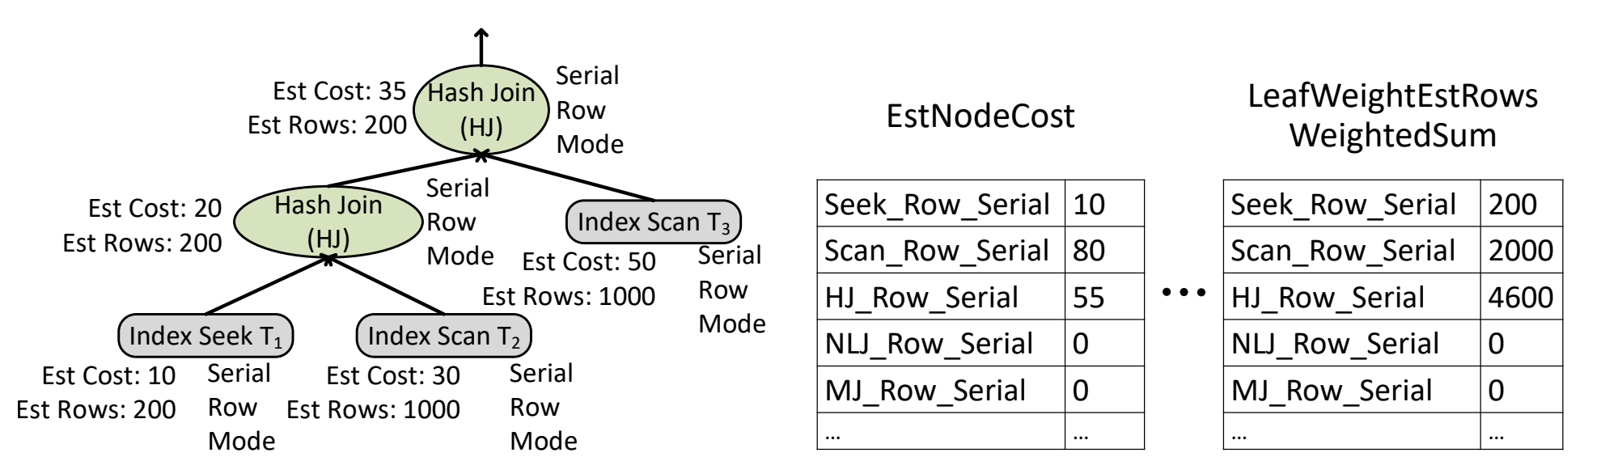
How to Featurize a Plan
The input to the classification task is a pair of query plans, where each query plan is a tree of operators.
Parallelism(serial ，parallel)
execution mode(row， batch)
Feature channel
key
Notes:
！！！！！图上的算数问题
行模式 批处理模式
Key：a)衡量计划中相应操作符完成的工作
b）编码结构信息
不同的编码方式——特征通道；对于同一个计划而言，每个通道具有相同的维度
EstNodeCost节点成本估计 Estimated node cost as node weight (work done).
LeafWeightEstRowsWeightedSum Estimated rows as leaf weight and weight sum as node weight (structural information).
我们为每个节点分配权重，该权重是从计划中的叶节点到根递归计算的。 每个叶节点具有权重，即由特征通道计算出来的值。每个节点都有一个高度，即从 1 开始为叶子，然后 在叶子上方的每个级别上增加 1。节点的值是其所有子节点的权重×高度的总和。

Slide 7
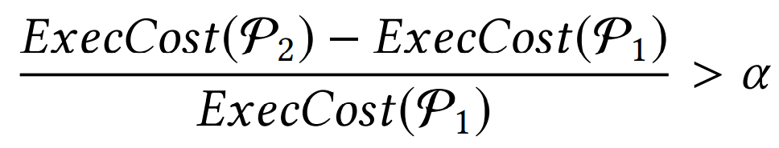


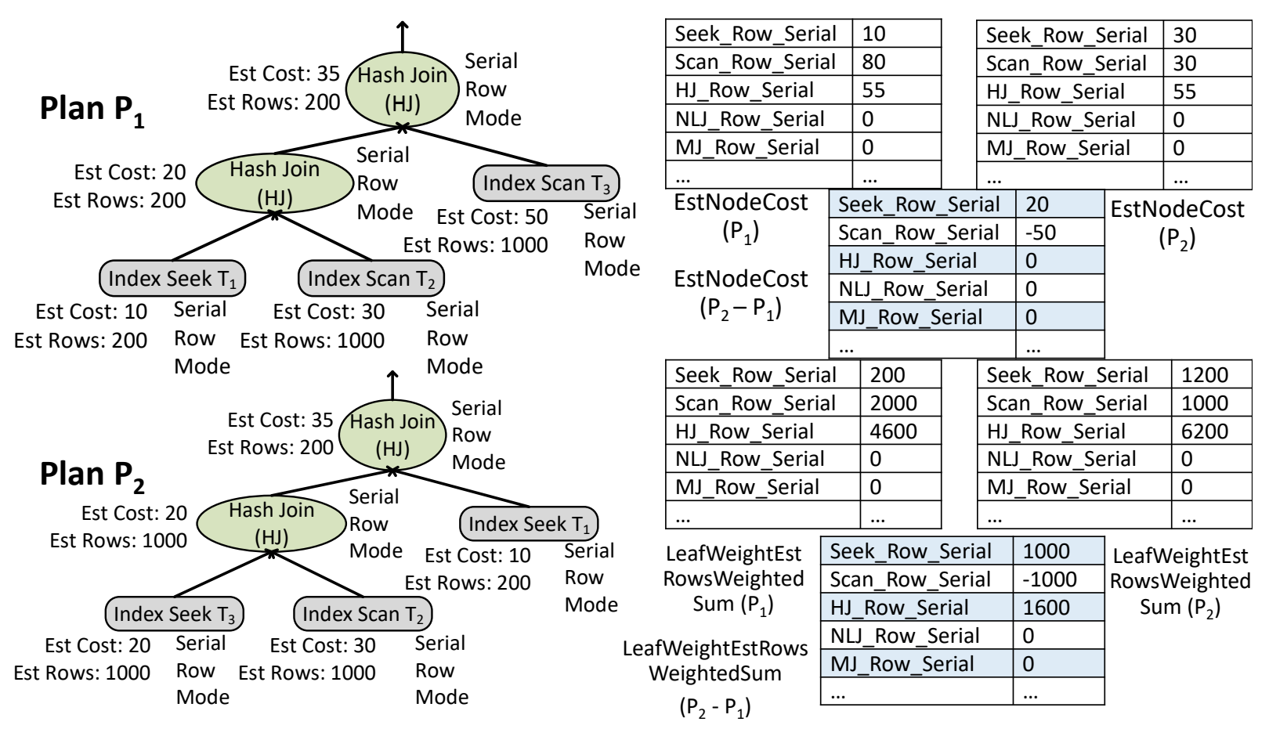
How to Featurize a Pair
is the execution cost of a plan
usually set to 0.2
pair_diff_normalized
Denominator：
sum of the values of all attributes for every channel
Numerator：
attribute-wise difference for every channel
Notes:
！！！！！pair_diff_normalized什么意思

Slide 8
Learning The Classifier
train/test data distributions differ across databases and even within a database across queries.
Need to Adaptation
Offline model can be per-database or even a global model for all databases.
Offline Model
Linear Models: Logistic Regression (LR)
Tree-based Models: Random Forest (RF), Gradient-boosted Trees (GBT)
Light GBM with gradient-boosted decision trees (LGBM)
Adaptation model
Advantage: lightweight, one database, trained on hundreds or a few thousands of plans
local Model
Disadvantage: overfit and generalize poorly to unseen queries
Offline Model
+
local Model
=
Adaptation model

Slide 9







Intergration With Index Tuner
1. no regression compared to
pre-specified threshold α
2. minimize the total query optimizer-estimated cost of W
query-level
false
candidate
configuration
find the optimal configuration for each query
true
1. that minimizes the optimizer’s
estimated cost of W
workload-level
find the optimal configuration for W by enumerating different sets of indexes obtained from phase query-level
2.
is false for all Qi ∈ W
Notes:
minimize the total query optimizer-estimated cost of W

Slide 10
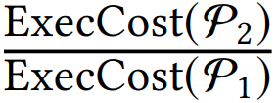
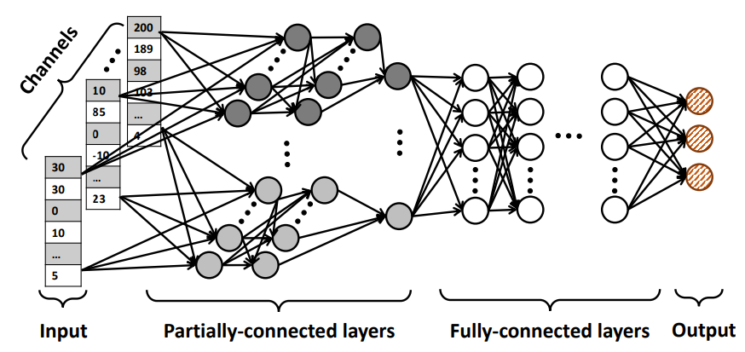
Alternatives
1、Alternative Learning Tasks —— three types of regressor
operator-level regressor :
1、execution cost of each operator 2、plan’s execution cost
plan-level regressor :
plan’s execution cost
plan pair regressor :
2、 Alternative Classifiers
Deep Neural Networks (Partially-connected)
Hybrid of DNN and Tree
Adapting DNNs (transfer learning)
Notes:
传递学习

Slide 11

Experimental Evaluation —— Set Up
Regression vs. classification
Offline model
The major facts evaluation focuses on
Need for adaptation and adaptive model
Improvement in index recommendations
Classifier（Precision, Recall, F1 score）
TPC-H (22) and TPC-DS (92)
Metrics
Workloads
Regression（TP, TN, FP, FN）
11 customers workloads
Pair (5)
Plan (5)
Different ways to construct the train/test sets
Query (10)
Database (5)
Featurize a Pair
Feature Channels
pair_diff_normalized
Notes:
Pair: split the union of all plan pairs into disjoint sets;
Plan: split the set of plans into two disjoint sets of plans from which the pairs are constructed. Plans in test are different from plans in training, simulating the setup where during the tuner’s search, the model is used to infer on new plans for new configurations.
Query: split the set of queries into two disjoint sets, and use the plans corresponding to queries in each set to construct the pairs. This corresponds to inference on new queries that did not appear in training.
Database: the test set is an unseen database for which no queries or plans appear in training. With these approaches of splitting, the train/test distributions become increasingly different, with most similarity for Pair and least for Database.

Slide 12
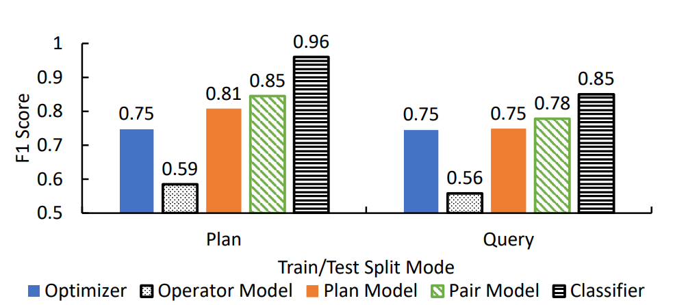
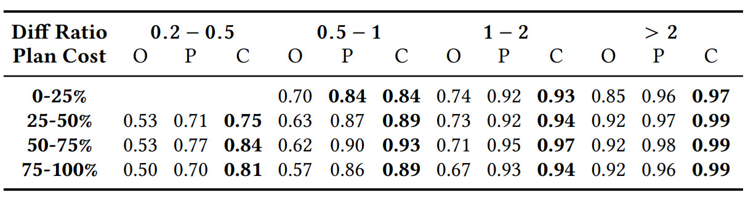



Experiment —— Regression vs. Classification
21%
10%
Train
60%
Test
40%
unseen plans：21%
unseen queries：10%
Plan Cost：
Diff Ratio：
-1

Slide 13
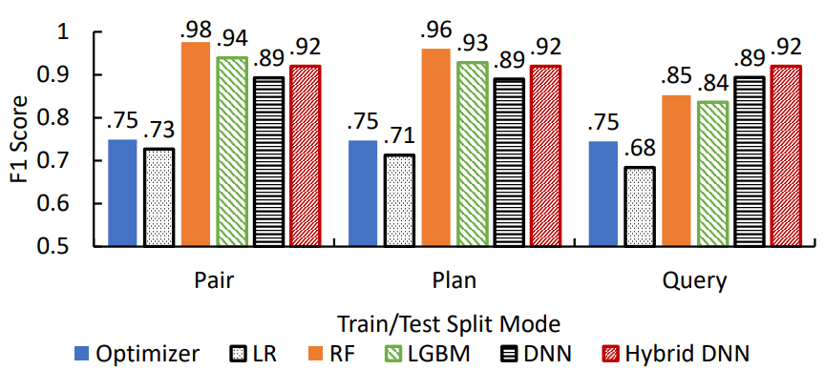
Experiment —— Offline Model
3 hidden layers for the partially-connected part
12 hidden layers for the fully-connected part
Hybrid DNN
64 neurons per hidden layer
RF with 50 trees over the output layers
Performance
Pair, plan: tree models
Query: DNN models
Time
RF: trains in 10+minutes
infers in 10-microsecond
DNN: trains in hours
infers in 10+ microseconds

Slide 14
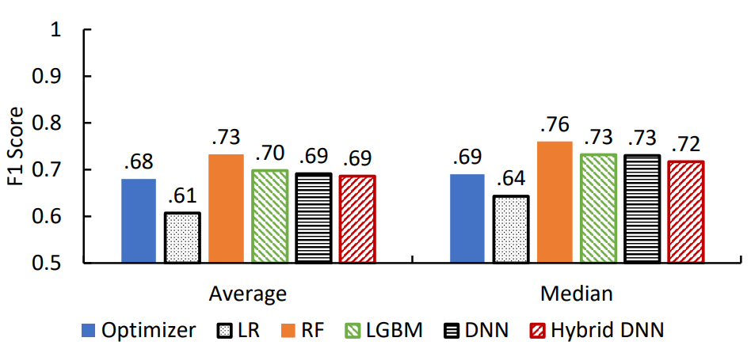
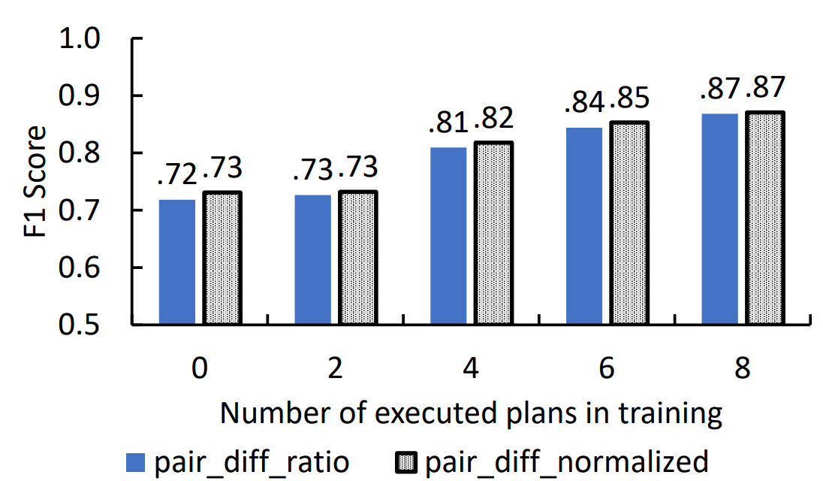
Experiment —— Need for Adaptation & Adaptive Model
14 training
15 databases
1 test
a signal of difference in train/test data distribution
performance
RF
how the models’ F1 scores change ?
a tiny fraction of plans from the held-out database
training

Slide 15
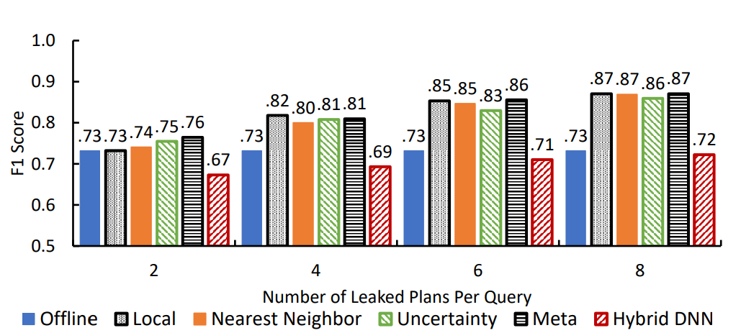
Experiment —— Need for Adaptation & Adaptive Model

Slide 16
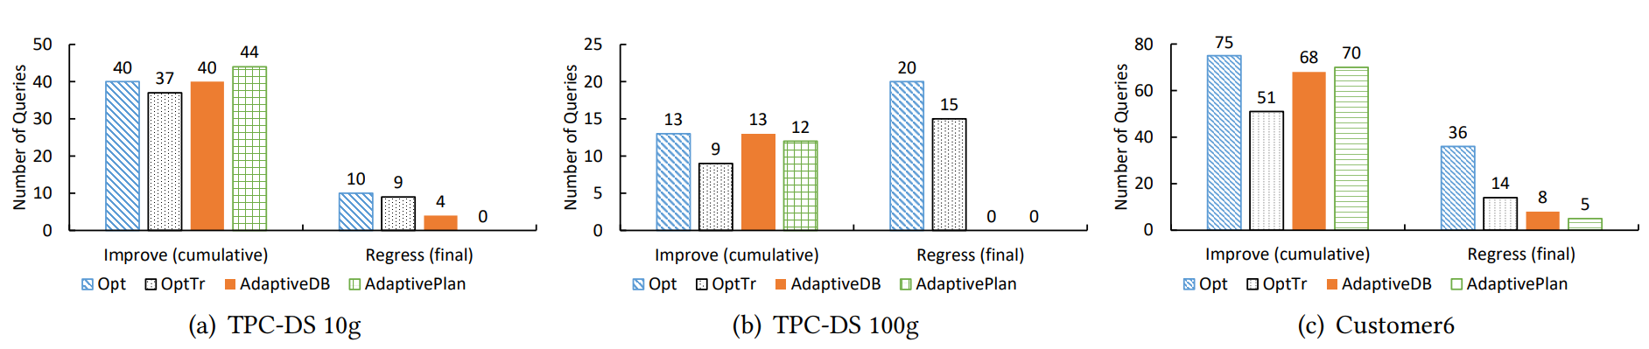
Experiment —— Index Recommendation Quality
The impact of RF-based classifier integrated into the index tuner on the end-to-end recommendation quality
Opt
Train data
OptTr : improvement is greater than a threshold
Split by plan (AdaptivePlan)
Iteration time: 10
Split by database (AdaptiveDB)
New execution data

Slide 17
Conclusion
1. Regression vs. classification
We observed a 2×−5× reduction in the ratio of errors when using the classifier to select the cheaper of a pair of plans compared with other learning or analysis models.
2. Offline model
We find that overall the RF-based models outperform others in accuracy and training efficiency.
3. Need for adaptation and adaptive model
We observe that the lightweight adaptive strategies are effective in reducing the fraction of errors in plan comparison by up to 2× with a tiny fraction of newly-labeled plans from the unseen database
4. Improvement in index recommendations
We observe that augmenting the index tuner with the model eliminates most regressions while preserving or even boosting the improvement.

Slide 18
Thank you for attention !

